Slide 1
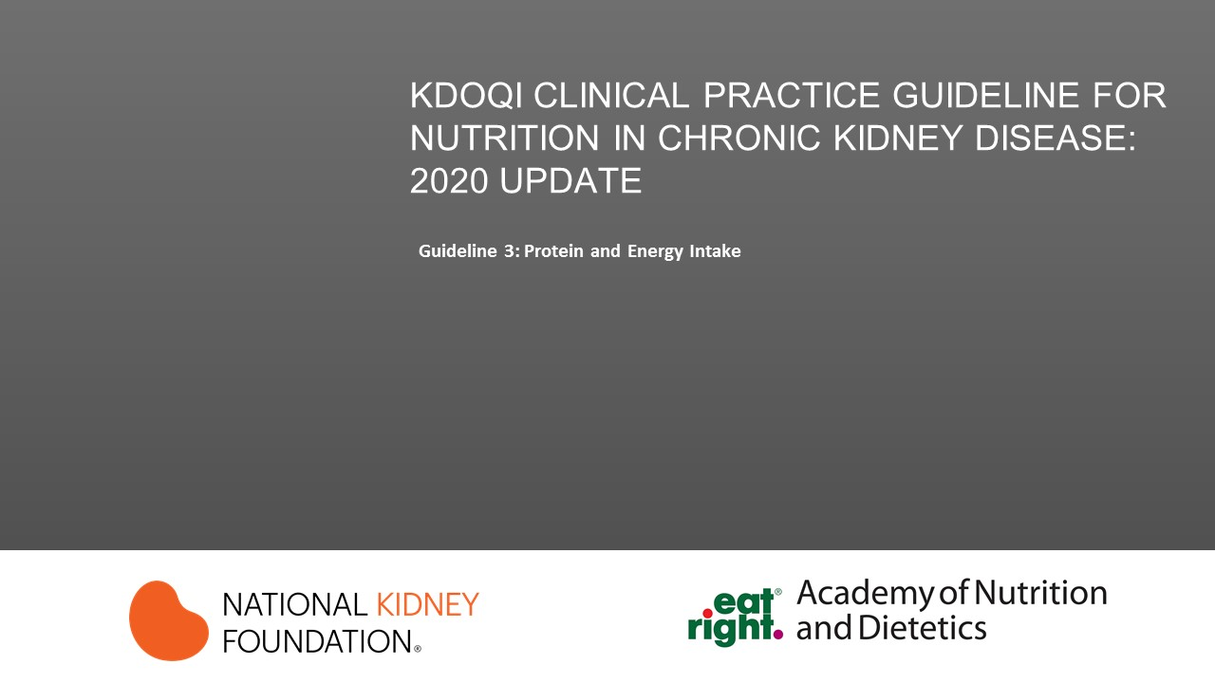



Slide 2
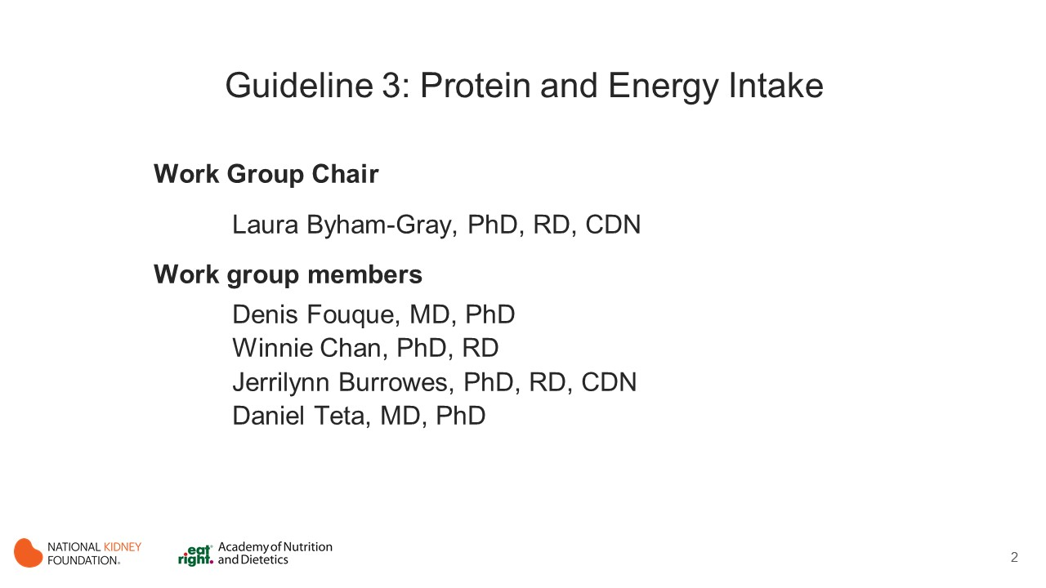
Notes:
Chapter Chair: Laura Byham-Gray, PhD, RD, CDN
Chapter Committee:
Denis Fouque, MD, PhD
Winnie Chan, PhD, RD
Jerrilynn Burrowes, PhD, RD, CDN
Daniel Teta, MD, PhD

Slide 3
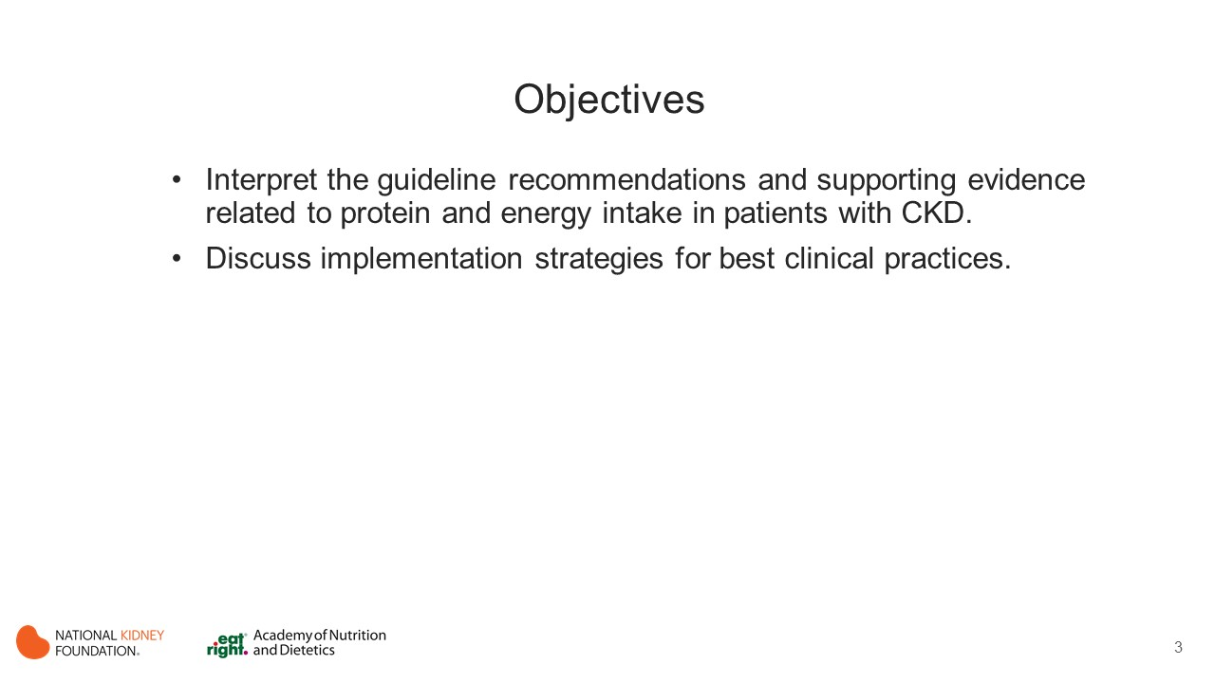
Notes:
The learning objectives for this activity are to:
Interpret the guideline recommendations and supporting evidence related to protein and energy intake in patients with CKD.
Discuss implementation strategies for best clinical practices.

Slide 4

Notes:
Sections
Protein Amount
Energy Intake
Protein Type
Dietary Patterns

Slide 5
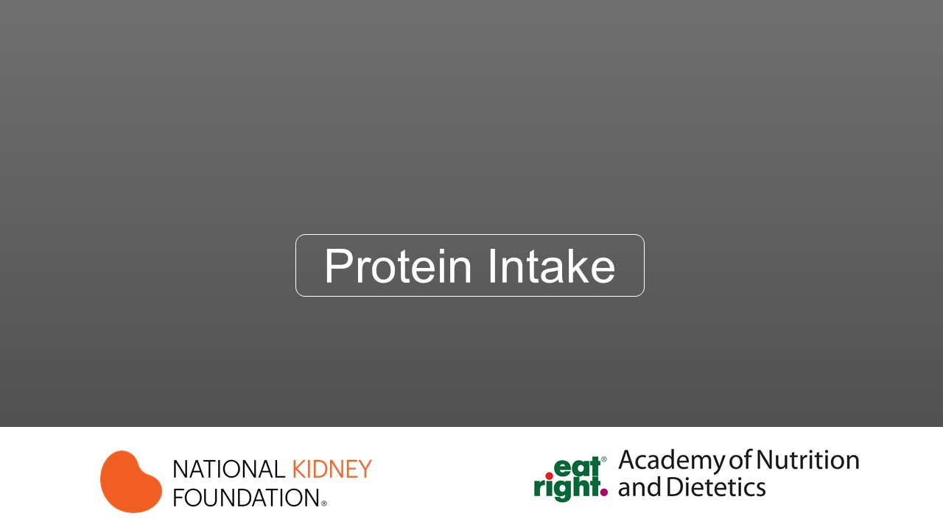

Slide 6
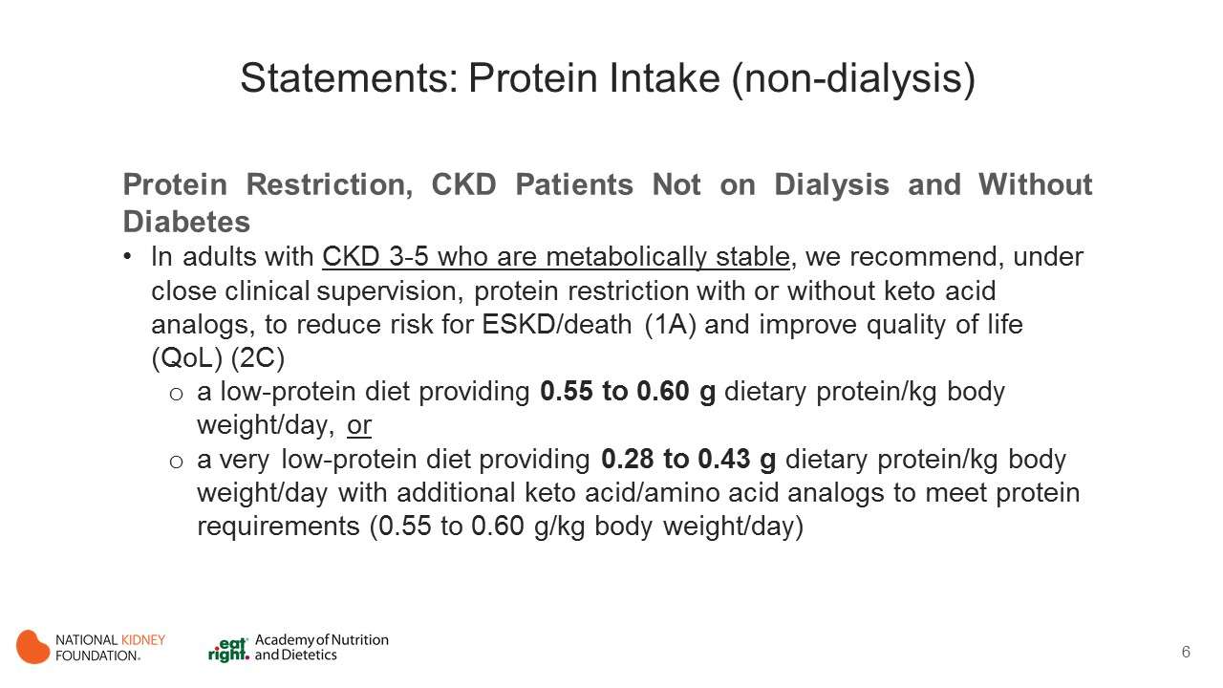
Notes:
Protein Intake
Reducing protein intake may impair nutritional status in individuals at risk for PEW.
It is a well-known fact that adults in Western countries eat above their minimum daily requirement (1.35 g protein/ kg per day) as compared with their optimal daily needs, estimated to be 0.8 g protein/kg per day.
Metabolic balances in healthy adults and patients with CKD have confirmed that, provided there is sufficient energy intake (e.g. >30 kcal/kg per day), the protein intake level can be safely decreased to 0.55 to 0.6 g protein/kg per day.
A further reduction in protein intake to 0.3 to 0.4 g protein/ kg per day can be achieved with the addition of pills of ketoacid analogues (KAs) to ensure a sufficient balance of the essential amino acids (EAAs) normally brought by animal proteins, which are basically absent in these low protein vegan-like diets.
Optimal metabolism of this lower range of protein intake requires adequate amount of caloric intake to promote protein sparing.
As a consequence of reducing uremia and uremic toxins on one hand and improving renal hemodynamics on the other hand, a reduction in protein intake may reduce clinical symptoms and postpone the need to start maintenance dialysis treatment.
Diabetes
The protein recommendations are higher in persons with diabetes because of the need to maintain glycemic control. Decreasing the protein too low will cause a shift to consume more carbohydrate and thereby increase blood glucose levels. The reason it is Opinion is because there is not any new literature on the topic, but the workgroup felt compelled to comment.

Slide 7
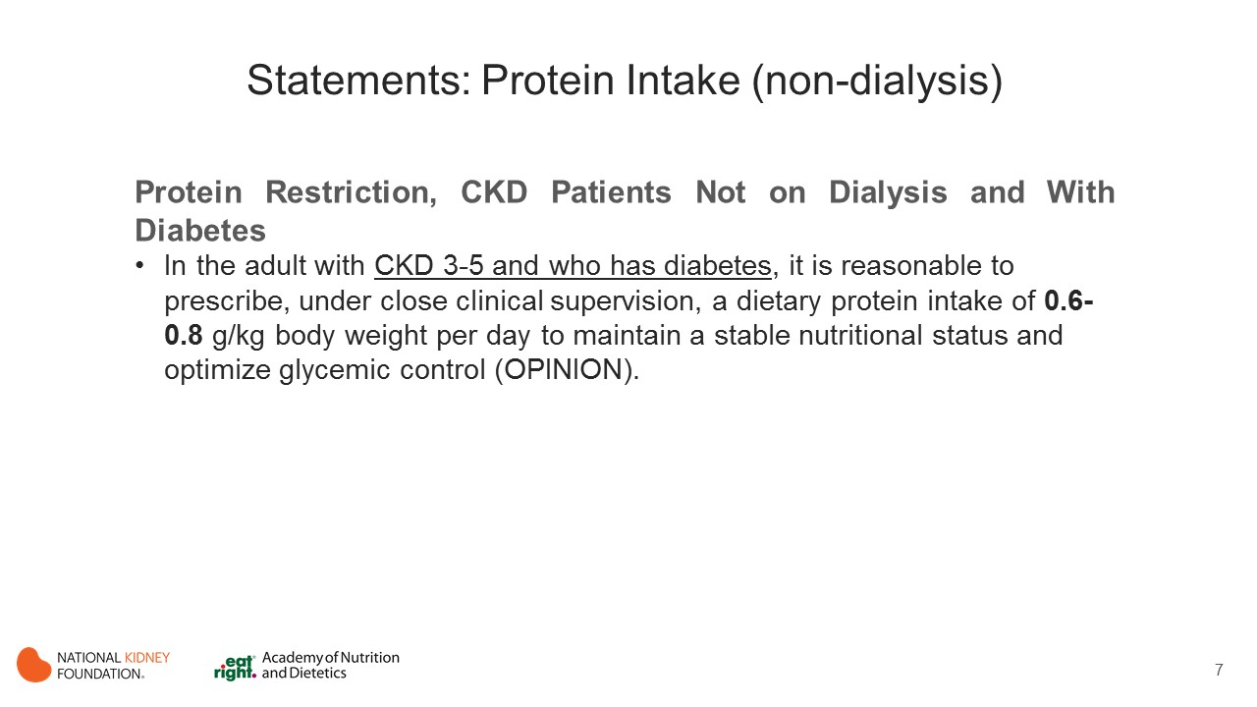
Notes:
Diabetes
The protein recommendations are higher in persons with diabetes because of the need to maintain glycemic control. Decreasing the protein too low will cause a shift to consume more carbohydrate and thereby increase blood glucose levels. The reason it is Opinion is because there is not any new literature on the topic but the workgroup felt compelled to comment.

Slide 8
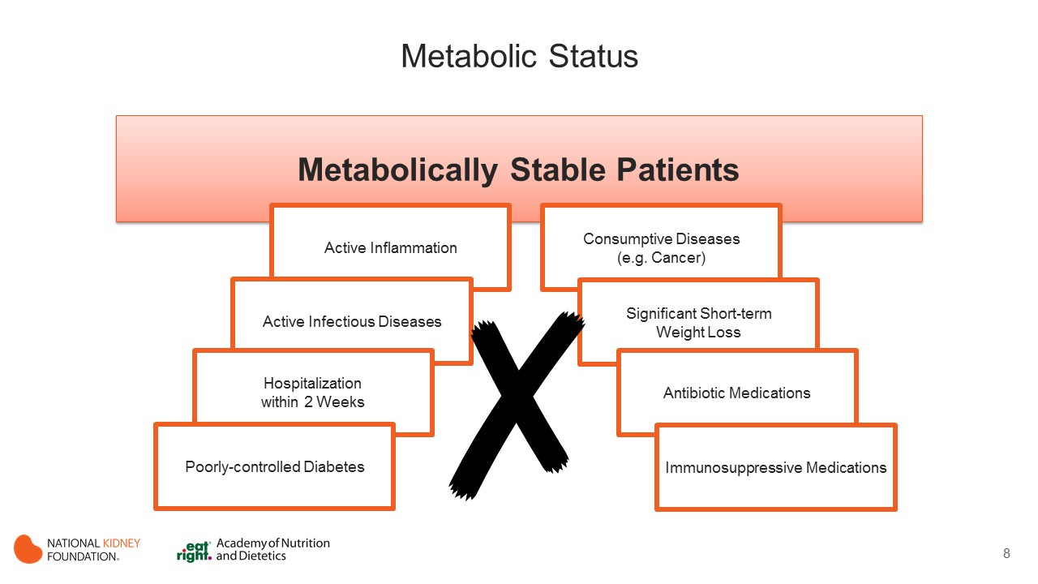
Notes:
Metabolically Stable
“Metabolically stable" means hemodynamically stable, without acute illness such as infection, malignancy... etc.

Slide 9
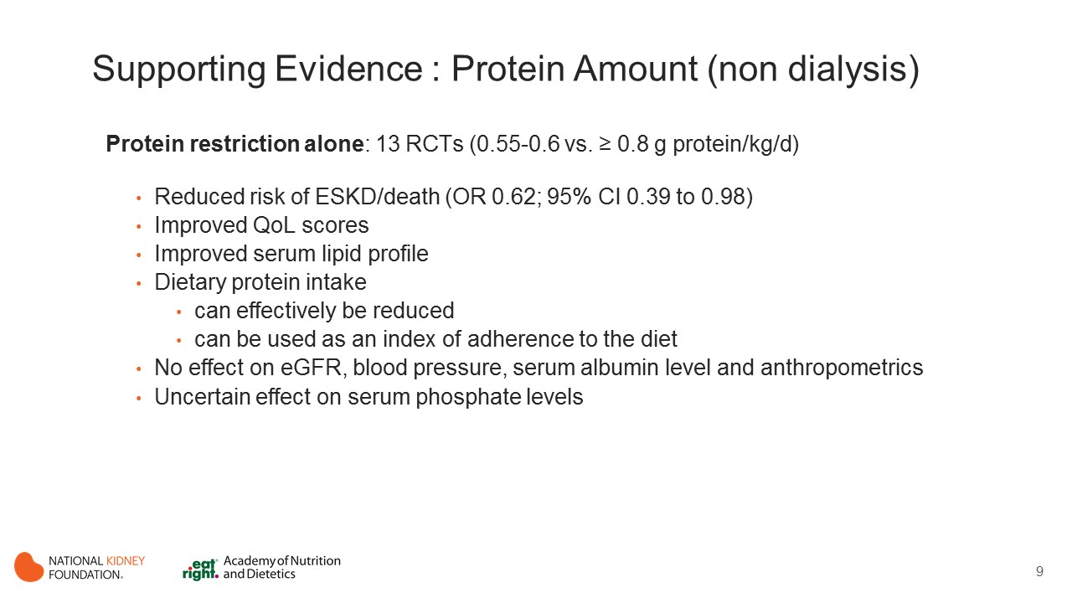
Notes:
Protein Restriction Alone
RCTs from 1985 to 2013; 0.55-0.6 vs. ≥ 0.8 g protein/kg/d (0.55-0.6 vs. ≥ 0.8 g protein/kg/d) Duration follow-up 3 to 48 months. (Kloppenburg 2004, Kuhlmann 1999, Sanchez 2010, Williams 1991, Cianciaruso 2009, Cianciaruso 2008, D”Amico 1994, Hansen 2002, Jesudason 2013, Locatelli 1989, Rosman 1989a, Rosman 1985, Rosman 1989b)
ESKD/death: beneficial effect of protein restriction (OR 0.62; 95% CI 0.39 to 0.98)
QoL: scores for general health and physical status improved significantly after protein restriction
Improvement in serum lipid profile
Dietary protein intake can effectively be reduced
Dietary intake can be used as an index of adherence to the diet
Protein restriction had no effect on eGFR, serum albumin level and anthropometrics
Uncertain effect on serum phosphate levels

Slide 10
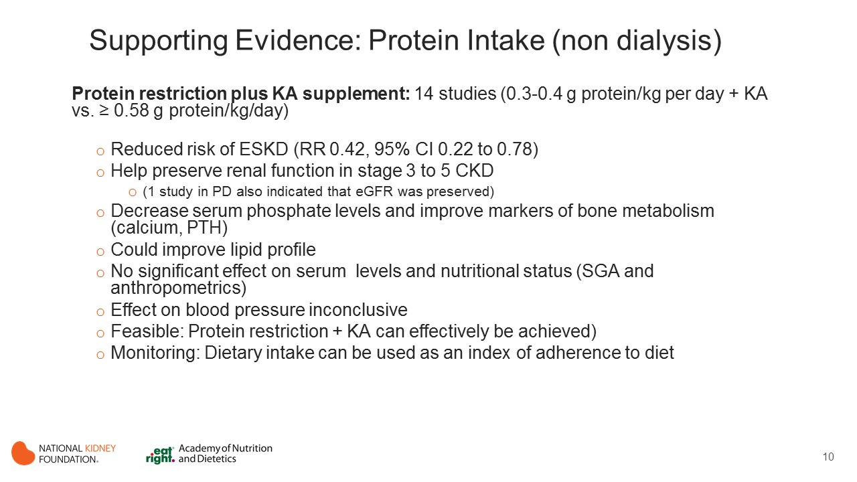
Notes:
Protein Restriction Plus KA Supplement
14 studies - RCT: Reiten 2005, Herselman 1995, Kopple 1997, LI 2011, Mircescu 2007, Prakash 2004, Coggins 1994, Jiang 2009, Jungers 1987, Klahr 1994, Levey 1996, Malvy 1999, Menon 2005; NRCT: Bellizzi 2007
ESKD: two newer studies show positive effects of protein restriction + KA (RR 0.42, 95% CI 0.22 to 0.78); evidence from older studies unclear effect on ESKD
Could help preserve renal function in stage 3 to 5 CKD (1 study in PD also indicated that eGFR was preserved)
Could decrease serum phosphate levels and improve markers of bone metabolism (calcium, PTH)
Had no significant effect on serum albumin levels and nutritional status (SGA and anthropometrics)
Effect on BP inconclusive
Could improve lipid profile
Protein restriction + KA can effectively be achieved
Dietary intake can be used as an index of adherence to diet

Slide 11
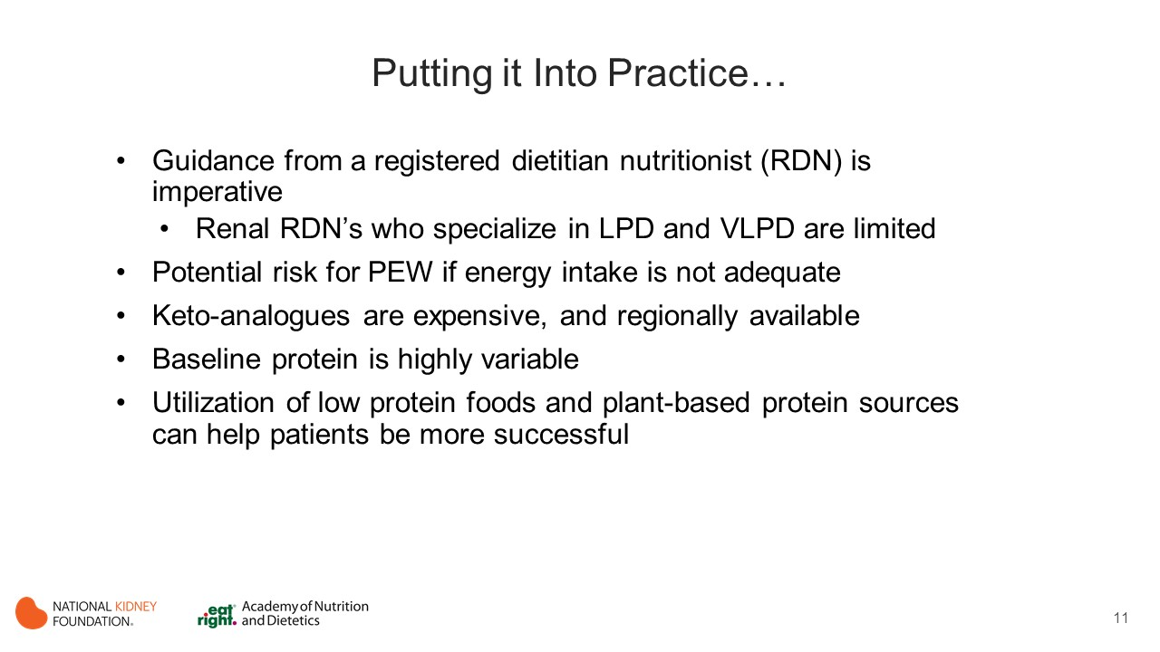
Notes:
It is important to establish overall health goals as a team.
Besides protein controlled diet, does the patient need to lose weight? to improve blood pressure?
Be sure to include the patient as the center of their own management.

Slide 12
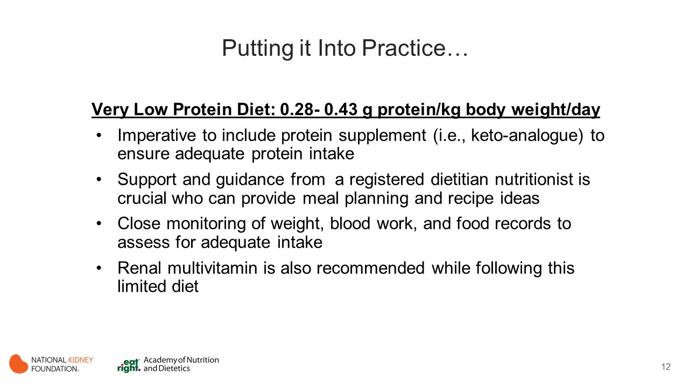

Slide 13
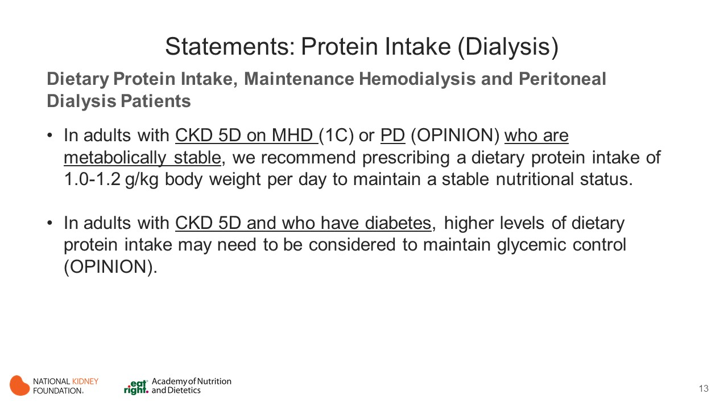
Notes:
Protein needs are higher for dialysis due to losses via the renal replacement therapies.

Slide 14
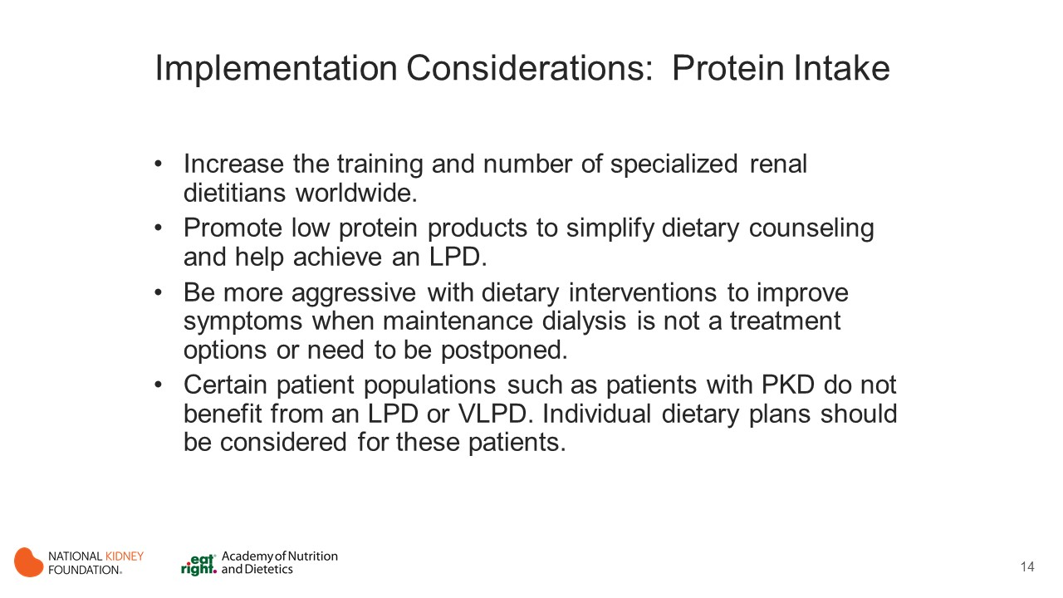
Notes:
These diets should be progressively installed to allow careful dietary counseling and adequate adherence.
Although such diets are not associated with wasting in carefully monitored research studies, on a routine basis, attention should be focused on energy intake, which may decrease over time and induce weight loss and wasting.
A potential beneficial effect of reducing protein intake relies on the fact that it also reduced glomerular hyperfiltration and potentially protects them from hyperfiltration, accelerated hyalinosis, and proteinuria.
From a nutritional point of view, reducing protein from animal sources and moving toward more fruits and vegetables also reduced acid production (NEAP) and metabolic acidosis, but "plant-based protein" is not necessarily less offensive to the ailing kidney. These effects are mostly observed for more reduced protein intakes (0.3-0.5 g/kg protein/kg per day) supplemented with KAs.

Slide 15
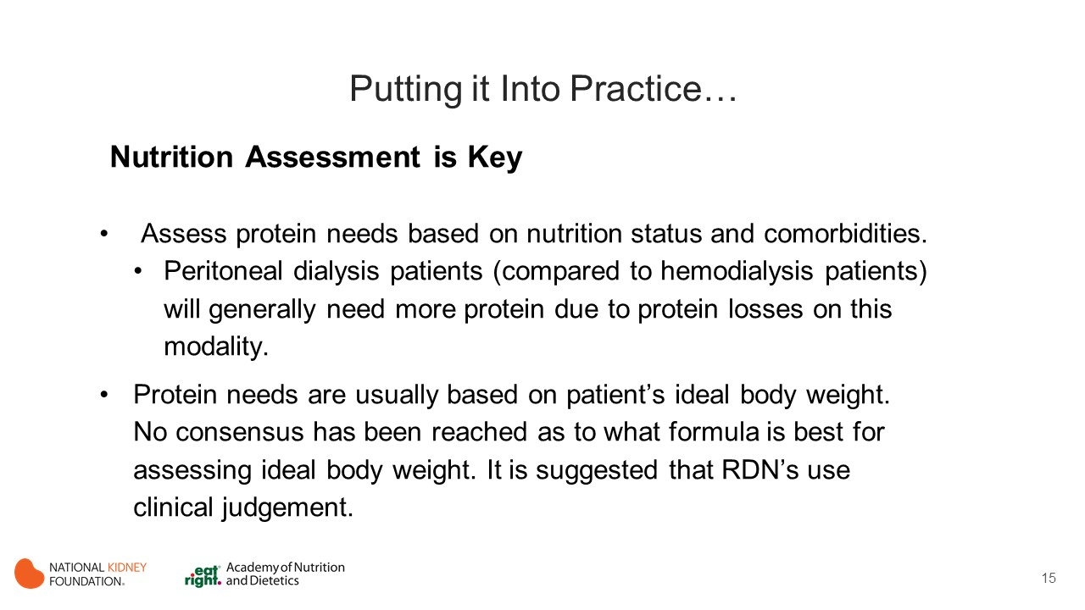

Slide 16


Slide 17
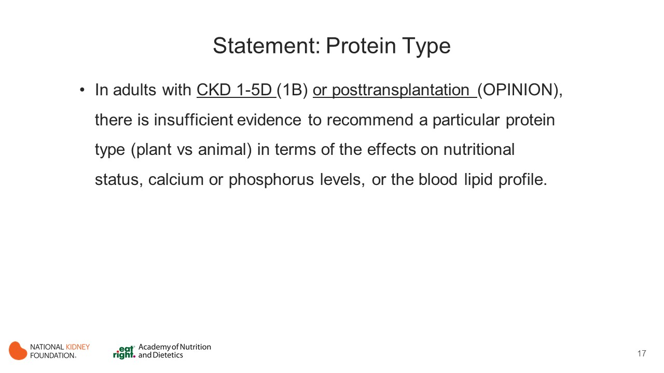
Notes:
Protein Type
In patients with CKD, vegetarian protein diets (VPDs) may have positive biological actions and possibly clinical benefits through a variety of mechanisms.
In vitro studies showed that VPDs reduce the expression of renin-angiotensin.
Studies in rodents demonstrated that VPDs retard the development and progression of CKD, versus animal protein diets (APDs), presumably through favorable effects on GFR.
A vegetarian diet was associated with a significant reduction in serum phosphate and FGF-23 levels in predialysis patients with CKD. As a result, it was thought that VPDs may be used in helping to reduce phosphorus load and potentially CKD progression in this group of patients.
By consuming more plant-based diet, more fruits and vegetable are consumed and therefore may have an indirect effect on NEAP.

Slide 18
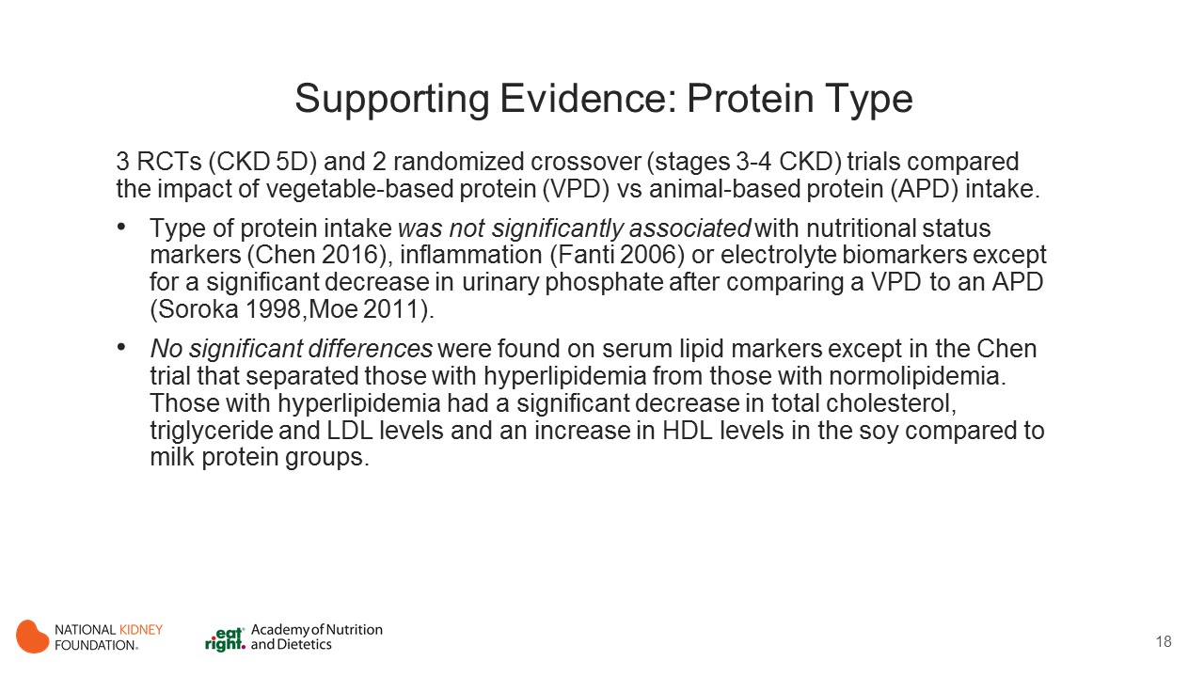
Notes:
3 RCTs (CKD 5D) and 2 randomized crossover (stages 3-4 CKD) trials (Moe 2011, Soroka 1998, Fanti 2006, Tabibi 2010, Chen 2016) compared the impact of vegetable-based protein (VPD) vs animal-based protein (APD) intake on biomarkers and health outcomes in patients with CKD, including:
Nutritional status (serum albumin, PCR, and prealbumin levels)
Inflammatory markers (CRP, IL-6, and TNF-alpha)
Electrolyte biomarkers (calcium and phosphorus levels)
Lipid profile (TC, LDL-C, HDL-C, and TG)

Slide 19
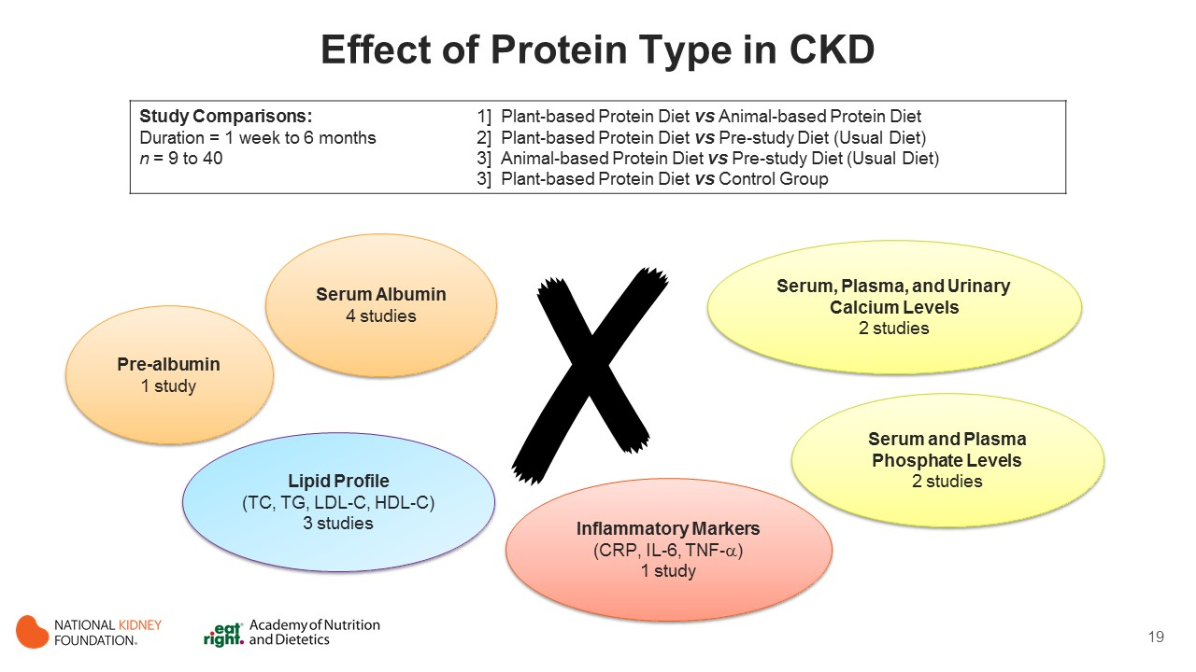
Notes:
Protein type had no effect on:
Nutritional status (serum albumin, PCR, and prealbumin levels)
Inflammatory markers (CRP, IL-6, and TNF-alpha)
Electrolyte biomarkers (calcium and phosphorus levels)
Lipid profile (TC, LDL-C, HDL-C, and TG)

Slide 20
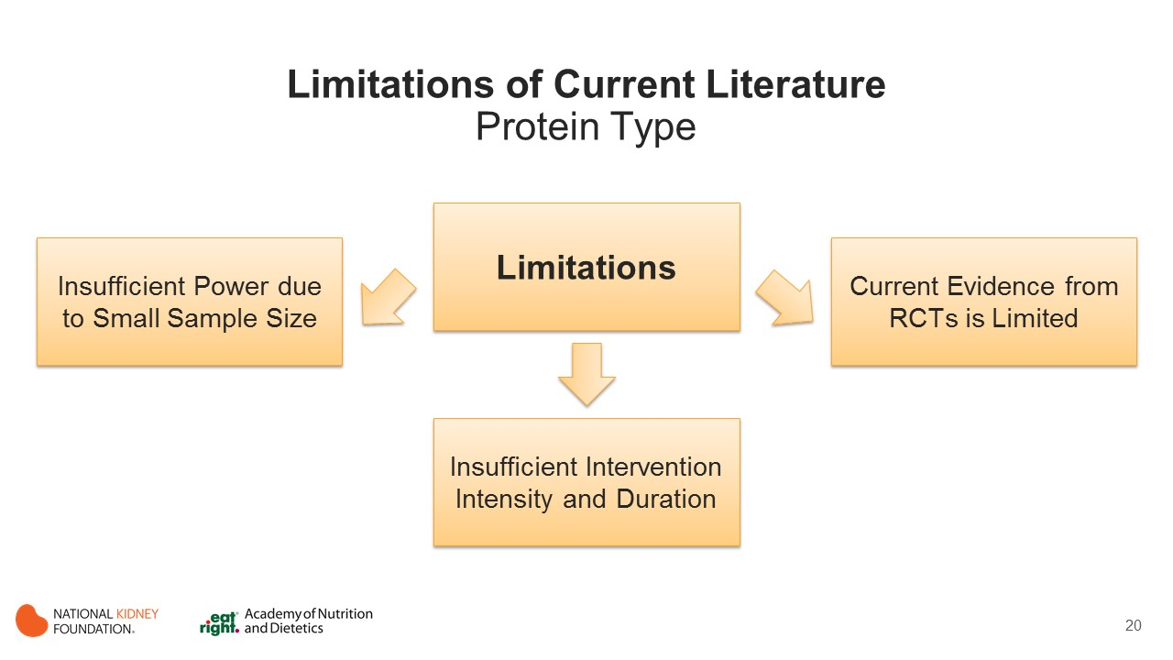
Notes:
Limitation of the current literature include:
Insufficient power due to small sample size
Insufficient intervention in terms of intensity and duration
Current evidence from RCTs is limited

Slide 21
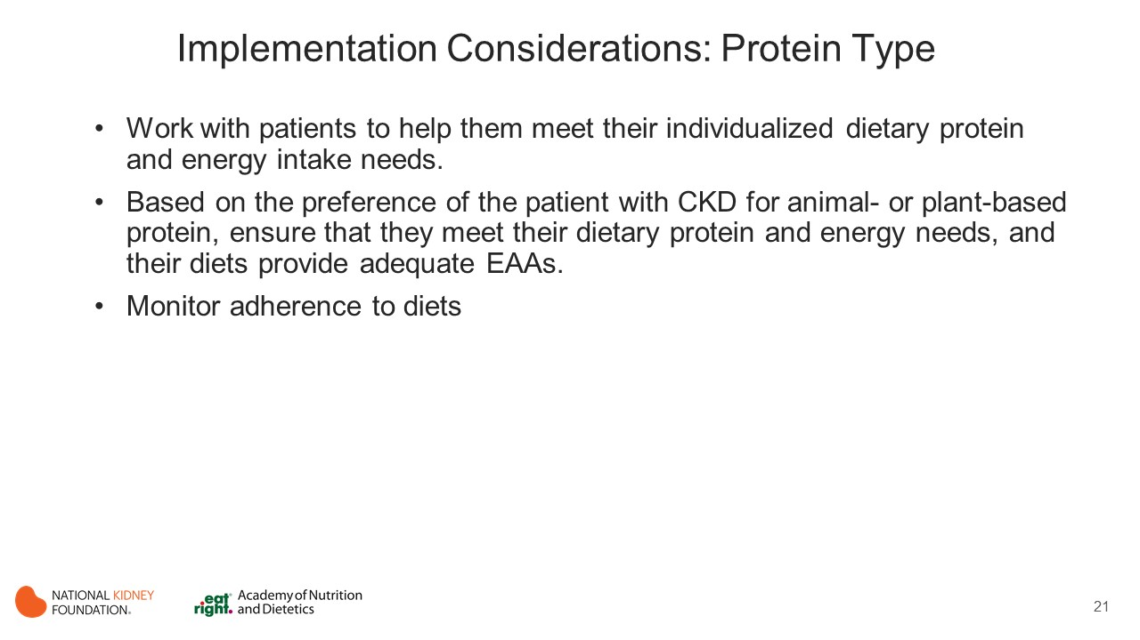
Notes:
(not edited/modified by JRP, believe this is part of DB main slides)
VPDs have been studied to test metabolic hypotheses in patients with CKD. In particular, phosphorus may be less absorbed during a VPD, which may benefit calcium and phosphate metabolism. This becomes more important because currently processed food contains much added inorganic phosphorus as compared with a VPD.
The fat content of a VPD possesses a healthier profile and may benefit patients in long-term studies.
Toxic middle molecules such as p-cresyl sulfate, indoxyl sulfate, and trimethylamine oxide, almost exclusively produced from animal source protein, could be reduced by VPDs and this hypothesis should be tested in long-term clinical trials in patients with CKD.
VPDs have shown reduction in acid load, increase in dietary fiber intake, and reduction of phosphorus and body weight.
There is increasing interest in the role of VPDs in CKD due to the benefits of this dietary pattern on CVD risk factors in the general population. However, current evidence from RCTs specifically comparing benefits of a VPD versus an APD in patients with CKD is limited.

Slide 22
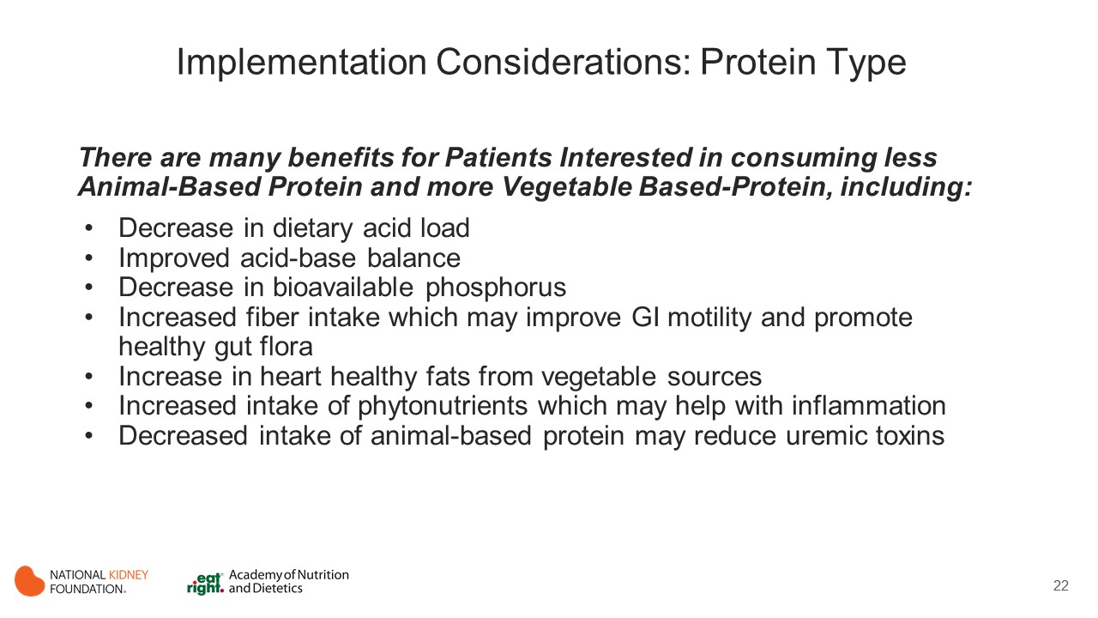

Slide 23
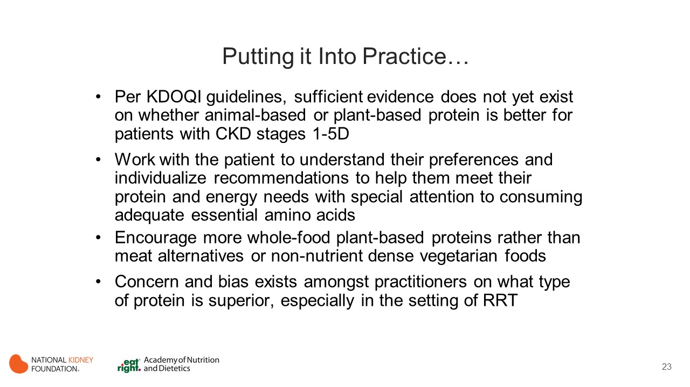
Notes:
Not a JRP slide

Slide 24
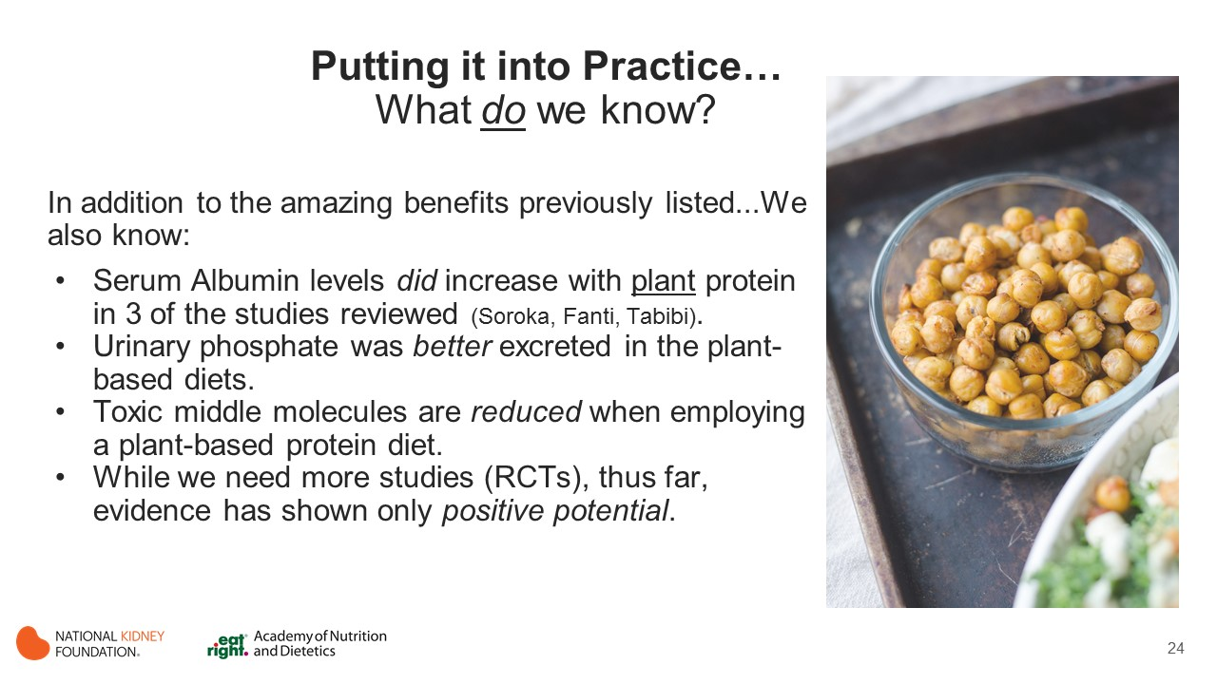
Notes:
Notes:
This significance reveals its non-inferiority as a method to increase albumin levels!
aka, less phosphate remained in the body.

Slide 25

Notes:
Making dietary changes is challenging for people who ae coping with kidney disease, but we can encourage them to start with cutting out meat just one day a week (e.g., Meatless Monday).
https://www.kidney.org/news/new-meatless-campaign-targets-vital-importance-kidneys-to-overall-health

Slide 26
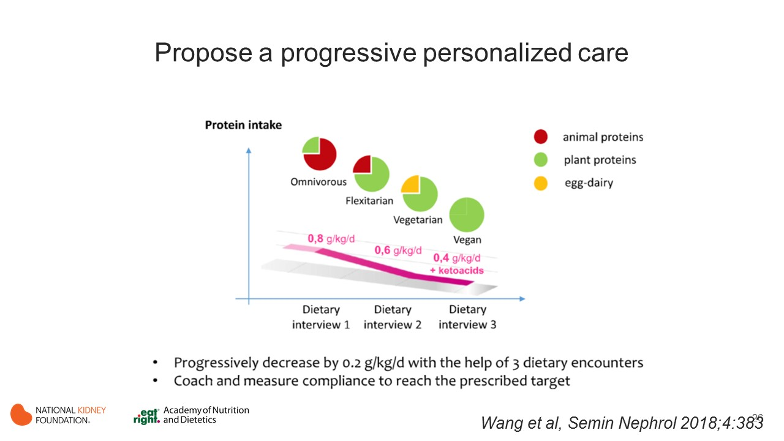
Notes:
Patients that are interested in following a vegetarian diet will benefit from the help of a registered dietitian nutritionist (RDN) to ensure that they are meeting individualized protein and energy needs and adequate essential amino acids.
Nutrition requirements can be met by including a variety of whole food plant-based sources of protein such as legumes, nuts/seeds, whole grains, and soy.

Slide 27


Slide 28
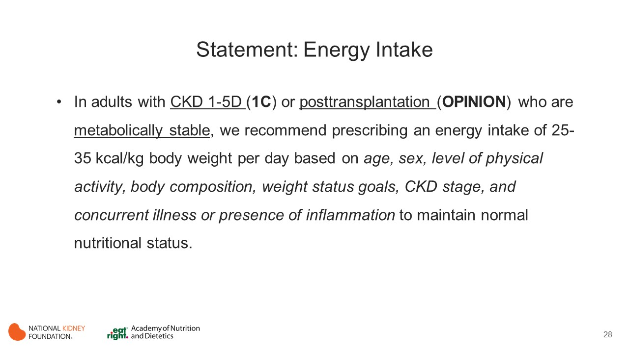
Notes:
Energy Intake
Energy metabolism may be impaired in patients with CKD. Hence, maintaining adequate energy intake is necessary to prevent PEW.

Slide 29
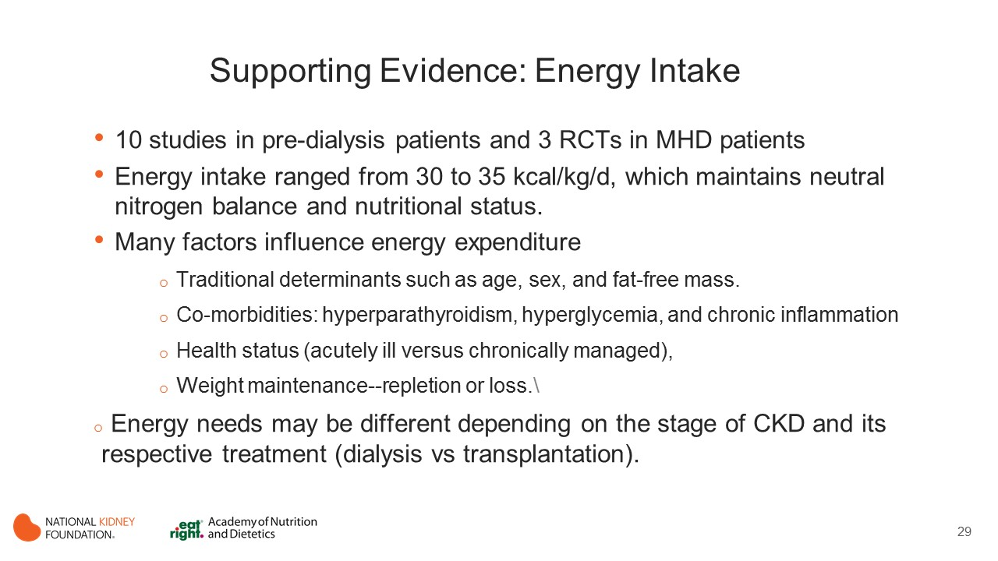
Notes:
Energy Intake
Evidence from 10 controlled trials in predialysis populations and from 3 studies in MHD patients indicates that energy intake ranging from 30 to 35 kcal/kg per day helps maintain neutral nitrogen balance and nutritional status. (Bellizzi 2007, Feiten 2005, Garneata 2016, Herselman 1995, Kloppenburg 2004, Kopple 1997, Kuhlmann 1999, Li 2011, Locatelli 1991, Mircescu 2007, Prakash 2004, Sanchez 2010, Williams 1991)
However, it is important to remember that many other factors may influence energy expenditure beyond traditional determinants such as age, sex, and FFM.
Some of these factors include hyperparathyroidism, hyperglycemia, and chronic inflammation that should be considered into the overall energy prescription; health status (e.g., acutely ill vs managed long term); overall health goals; and weight maintenance, repletion or loss.
There is still a paucity of controlled metabolic studies, as well as long-term well-designed outpatient clinical trials, studying energy intake in this population. Results from an old metabolic study examining energy requirements in MHD (sample size = 6) indicated that mean energy intake of 35 kcal/kg per day helped maintain neutral nitrogen balance and body composition.
Another similar study in 6 individuals indicated that average intake of 38 kcal was desirable to maintain neutral nitrogen balance. Recent review articles not included in this evidence review also suggest that energy intake in the range of 30 to 35 kcal/kg per day is appropriate to maintain neutral nitrogen balance and nutritional status, although not based on additional research studies.

Slide 30
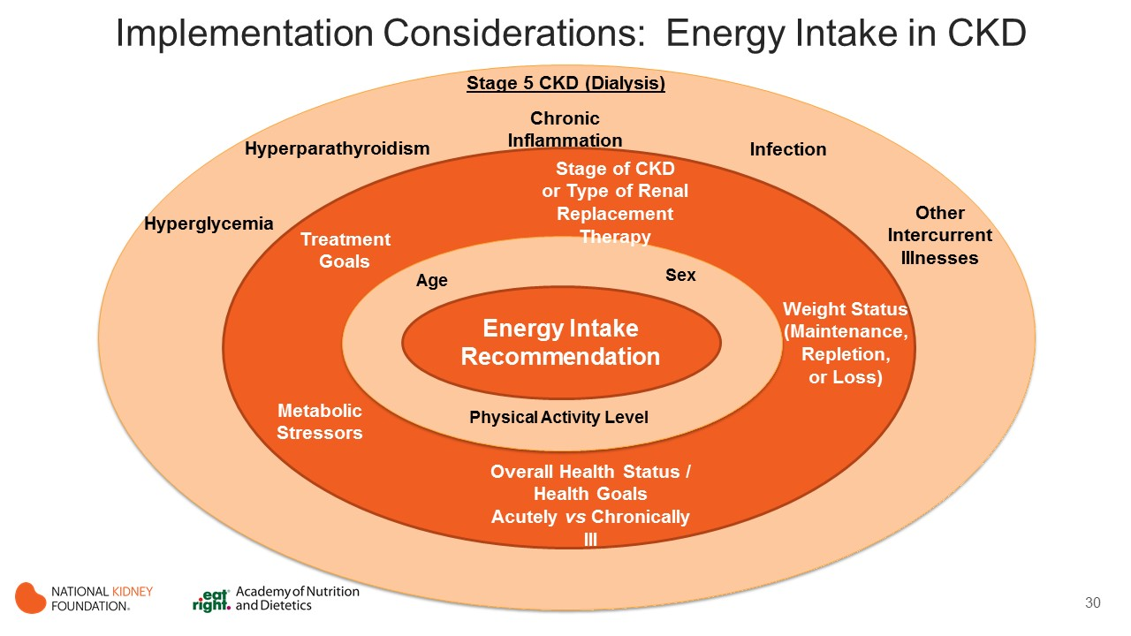
Notes:
Among patients with stage 5 CKD receiving dialysis, there are several factors that may influence energy expenditure beyond the traditional determinants (age, sex, and FFM), such as hyperparathyroidism, hyperglycemia, chronic inflammation, infections, and other intercurrent illnesses that should be considered into the overall energy prescription.

Slide 31
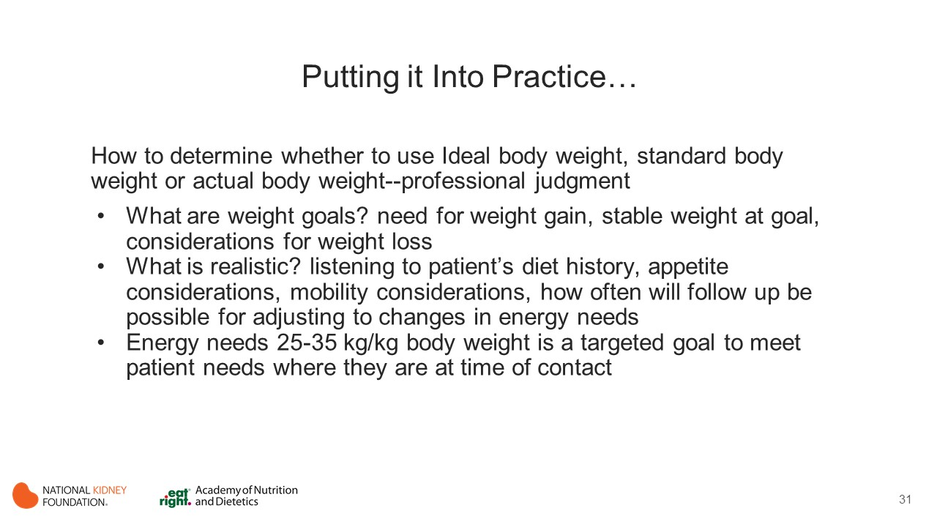

Slide 32


Slide 33
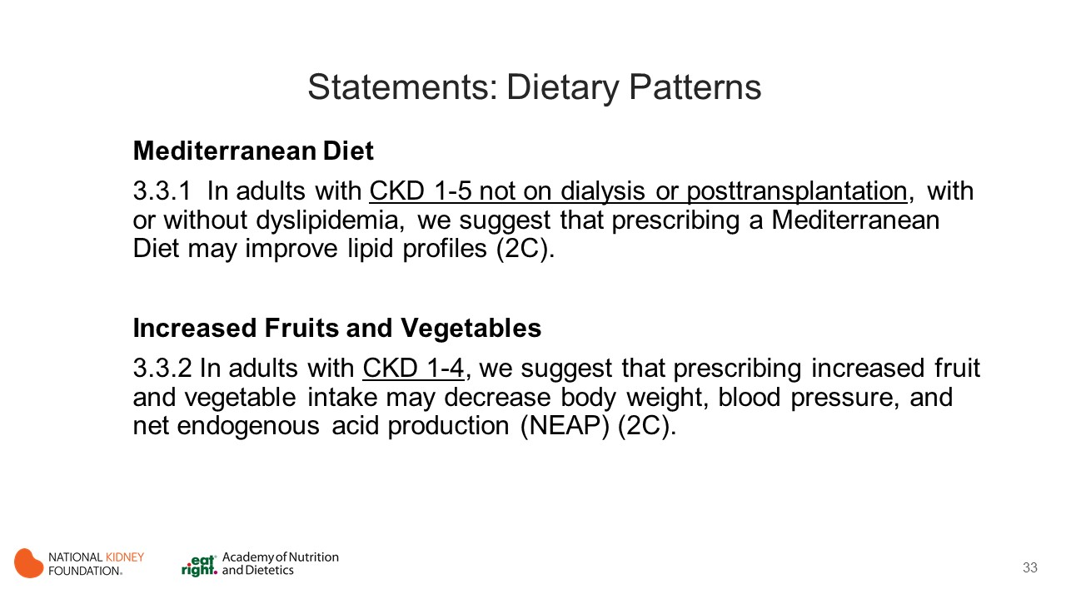
Notes:
Traditionally, nutrition education has focused on individual nutrients, such as protein, phosphorus, potassium, and sodium. Recent evidence has linked healthy dietary patterns with reduced chronic CVD and mortality risk in the healthy population. However, these relationships have not been explored conclusively with the CKD population.
Although various dietary patterns were investigated (fruits and vegetables, Mediterranean diet, low-fructose diet, hypolipidemic, carbohydrate-restricted low iron polyphenol-enriched diet, and high-protein/low-carbohydrate), there was little evidence examining the efficacy of most of these patterns in controlled trials. Hence, only the Mediterranean and high fruit and vegetable dietary patterns had sufficient evidence to create recommendations.

Slide 34
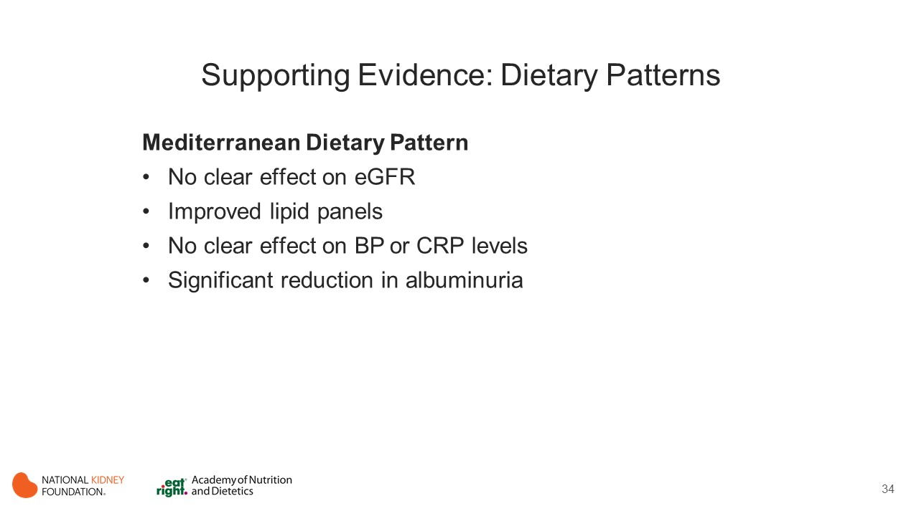
Notes:
Mediterranean Dietary Pattern
Estimated GFR
One RCT reported on the effect of the Mediterranean dietary pattern on eGFR. Mekki 2010 indicated no clear effect of the Mediterranean dietary pattern on eGFR at 90 days post intervention in adults with CKD stage 2. Additional research on the effect of the Mediterranean dietary pattern is needed.
Lipid Profile
Limited evidence from 3 studies, 2 of which examined non dialyzed patients (CKD stages 2 and 3) and 1 of which examined posttransplant patients, demonstrated that the Mediterranean diet improved lipid panels by decreasing total cholesterol (TC), LDL-C, and triglyceride (TG) levels compared with control groups.
Two controlled trials reported on the effect of the Mediterranean dietary pattern on lipid profiles in nondialyzed patients (Mekki 2010, DiDaniele 2014).
In the RCT, Mekki et al (CKD stage 2) reported a 35% reduction in TC levels (P < 0.05) in the Mediterranean diet group, whereas no change in TC levels was observed in the control group. LDL-C and TG levels were also reduced compared to standard care.
In an non RCT, Di Daniele et al reported a significant reduction in TC levels in both the Mediterranean diet group and the organic Mediterranean diet group. However, most reduction was noted in the organic Mediterranean diet group.
In posttransplant patients, 1 RCT reported that the Mediterranean diet led to significant reductions in TC, TG, and LDL-C levels compared with a low-fat diet (Stachowska 2005).
Other Outcomes
Compared with a control group, the Mediterranean diet had no clear effect on BP in posttransplant patients (Stachowska 2005) or on CRP levels in CKD stage 2 patients (Mekkii 2010).
1 non RCT reported on the effect of the Mediterranean dietary pattern on albuminuria in adults with stages 2 and 3 CKD, and both Mediterranean diet groups (normal and organic) had significant reductions in albuminuria values compared with the low-protein group (Di Daniele 2004).

Slide 35
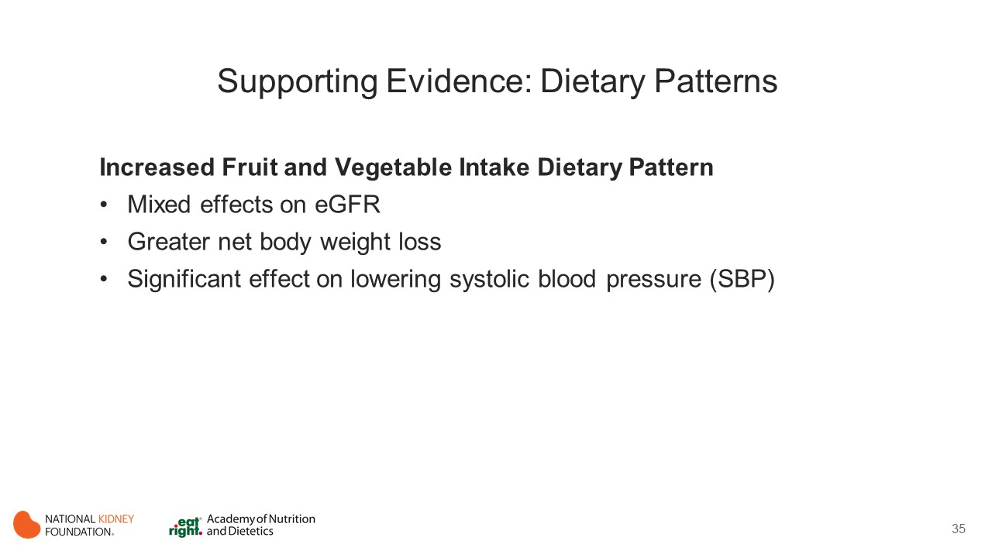
Notes:
High Fruit and Vegetable Dietary Pattern
CKD Progression
In adults with stages 3-4 CKD, the increased fruits and vegetables dietary pattern has mixed effects on eGFR compared with oral bicarbonate supplementation (Goraya 2013, Goraya 2014).
Body Weight
Two RCTs reported on the effect of an increased fruit and vegetable dietary pattern on body weight in adults with CKD.
Goraya et al (2014) reported that the group following the increased fruit and vegetable dietary pattern had greater net body weight loss than both the oral-bicarbonate and standard-care groups (P < 0.05).
Goraya et al (2013) reported lower body weight in adults with CKD stages 3-4 following an increased fruit and vegetable dietary pattern compared with the oral bicarbonate supplementation group at the 1-year follow-up (P < 0.01; mean difference, −5.09; 95% CI, −7.73 to 2.44 kg; I2 = 56%).
Blood Pressure
Three studies (2 RCTs and 1 non RCT) reported on the effect of increased fruit and vegetable intake on BP in adults with CKD. All 3 studies indicated that increased intake of fruits and vegetables had a significant effect on lowering systolic blood pressure (SBP) compared with the oral bicarbonate supplement group or standard-care group (Goraya 2013, Goraya 2014, Goraya 2012).
Goraya et al (2014) indicated reductions in SBPs in all groups; however, the 3-year value for the increased fruits and vegetables group was lower than those in bicarbonate supplement and control groups.
Goraya et al (2013) showed that compared with the bicarbonate group, the increased fruits and vegetables group had lower SBPs at the 1-year follow-up (P < 0.01).
Goraya et al (2012) (non RCT) showed that increased fruit and vegetable intake, but not control or bicarbonate supplementation, significantly decreased SBPs in individuals with CKD stages 1 and 2 (P < 0.001).
Pooled analysis of data from Goraya et al (2013) and Goraya et al (2014) indicated a mean difference of −5.6 (95% CI, −8.3 to −2.8) mmHg. Increased fruit and vegetable dietary pattern group lowered SBP compared with oral bicarbonate supplement intake or the standard-care group in adults with CKD stages 1-4.

Slide 36
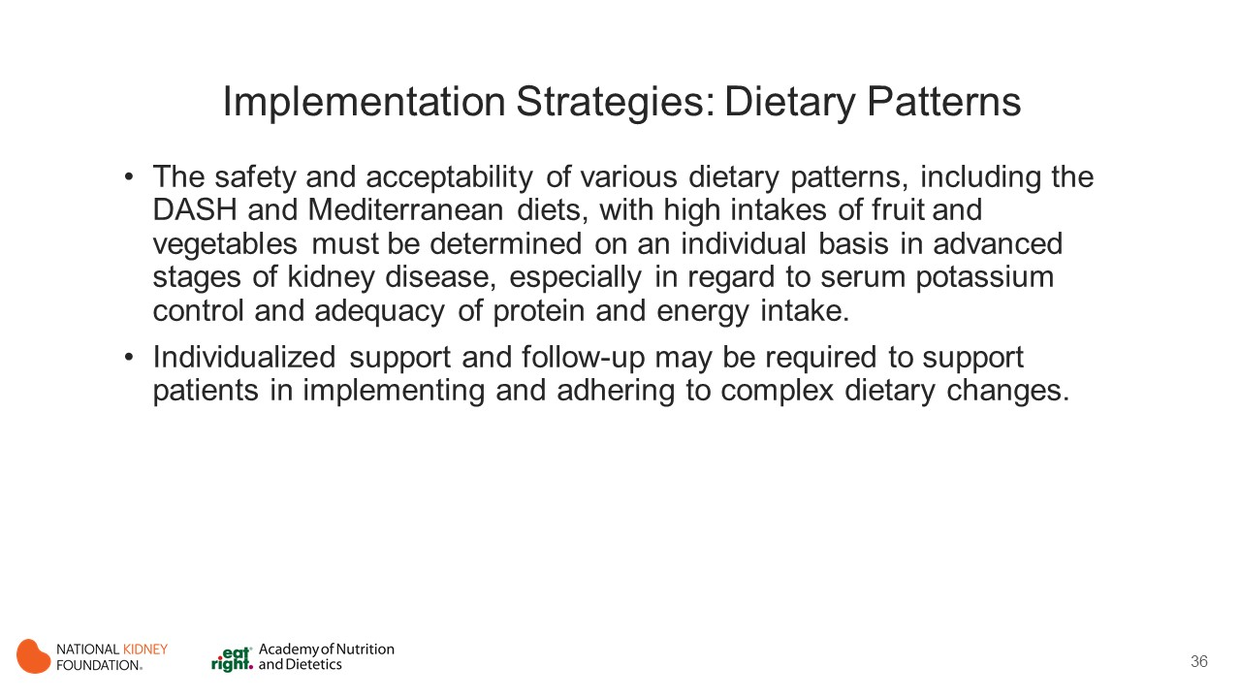
Notes:
Although the intervention studies examining dietary patterns in CKD are limited, there is consistent evidence from observational analyses on dietary patterns containing fruits, vegetables, whole grains, lean meats, low-fat dairy, and low added salt and improved clinical outcome (notably mortality) in CKD.
A recent study confirmed that intake of nuts, low-fat dairy products, and legumes is protective against the development of CKD. (Kellly 2017)
There is therefore a need to undertake future trials to further investigate more holistic dietary interventions over single nutrient approaches in these patients.
Dietary pattern may improve additional outcomes not reported in the systematic review, including constipation.

Slide 37
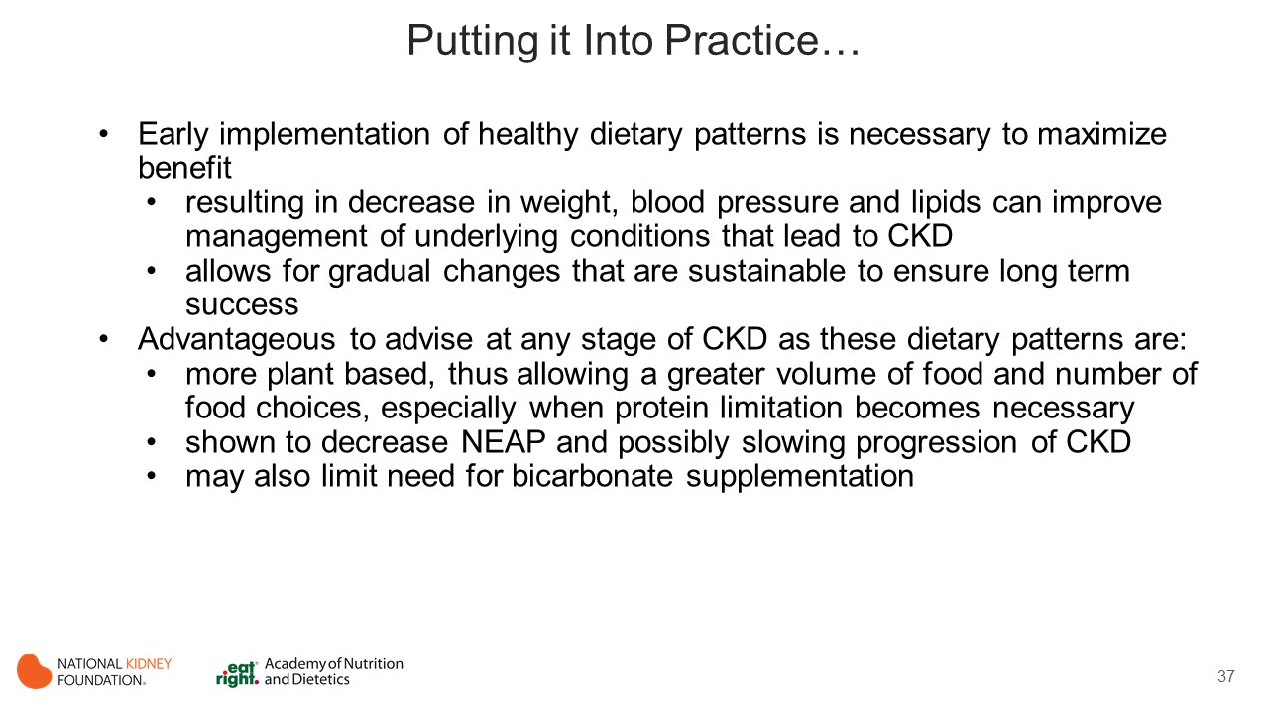
Notes:
Early implementation of healthy dietary patterns is necessary to maximize benefit
such changes have been shown to decrease body weight, blood pressure and lipids which can improve management of underlying conditions that can lead to CKD (e.g. DM, HTN and CVD)
intervention studies examining dietary patterns in CKD are limited, but there is consistent evidence from observational analyses regarding the benefit of dietary patterns containing fruits, vegetables, whole grains, lean meats and low-fat dairy while being low in added salt (i.e. sodium) with respect to improved clinical outcome (notably mortality) in CKD.
a recent study confirmed that intake of nuts, low-fat dairy products, and legumes is protective against the development of CKD (Kelly 2017).
dietary pattern may improve additional outcomes not reported in the systematic review, including constipation.
can allow for gradual changes that are sustainable making success more likely for the patient who has suffered from chronic medical concerns
It is advantageous to advise a healthy dietary pattern at any stage of CKD
healthy dietary patterns are more plant based and thus allow a greater volume of food and food choices, especially when protein limitation becomes necessary, leading to greater adherence to the diet
adopting a diet higher in fruits and vegetables has been shown to decrease net endogenous acid production (NEAP) and possibly slowing progression of CKD. May also limit the need for bicarbonate supplementation which can contribute a significant amount of unwanted sodium intake at higher dosages. Avoidance of bicarb supplementation lessens the pill burden as well.
The safety and acceptability of various dietary patterns, including the DASH and Mediterranean diets, with high intakes of fruit and vegetables must be determined on an individual basis in advanced stages of kidney disease, especially in regard to serum potassium control and adequacy of protein and energy intake.
There is a need to undertake future trials to further investigate more holistic dietary interventions over single nutrient approaches in these patients.

Slide 38
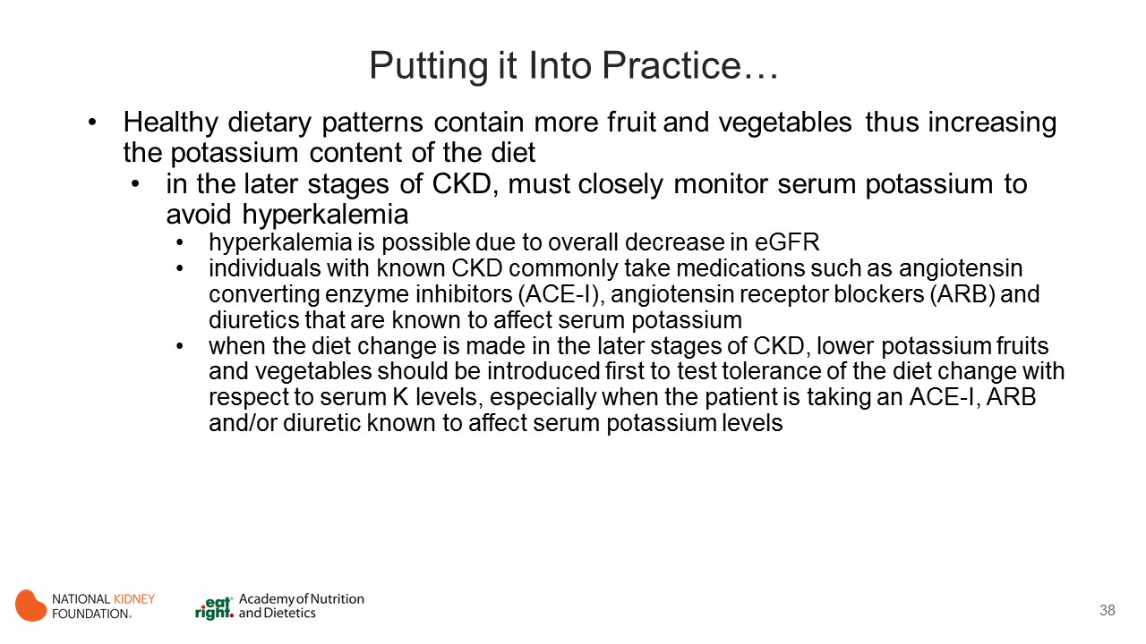
Notes:
Healthy dietary patterns contain more fruit and vegetables thus increasing the K content of the diet
in the later stages of CKD, must closely monitor serum K to avoid hyperkalemia
in stages 4 and 5 CKD, hyperkalemia is possible due to overall decrease in eGFR
individuals with known CKD commonly take medications such as angiotensin converting enzyme inhibitors (ACE-I), angiotensin receptor blockers (ARB) and diuretics that are known to affect serum potassium
these medications are cardio and renal protective as they reduce BP, proteinuria and progression of CKD
when the diet change is made in the later stages of CKD, lower potassium fruits and vegetables should be introduced first to test tolerance of the diet change with respect to serum K levels, especially when the patient is taking an ACE-I, ARB and/or diuretic that is known to affect serum potassium levels

Slide 39
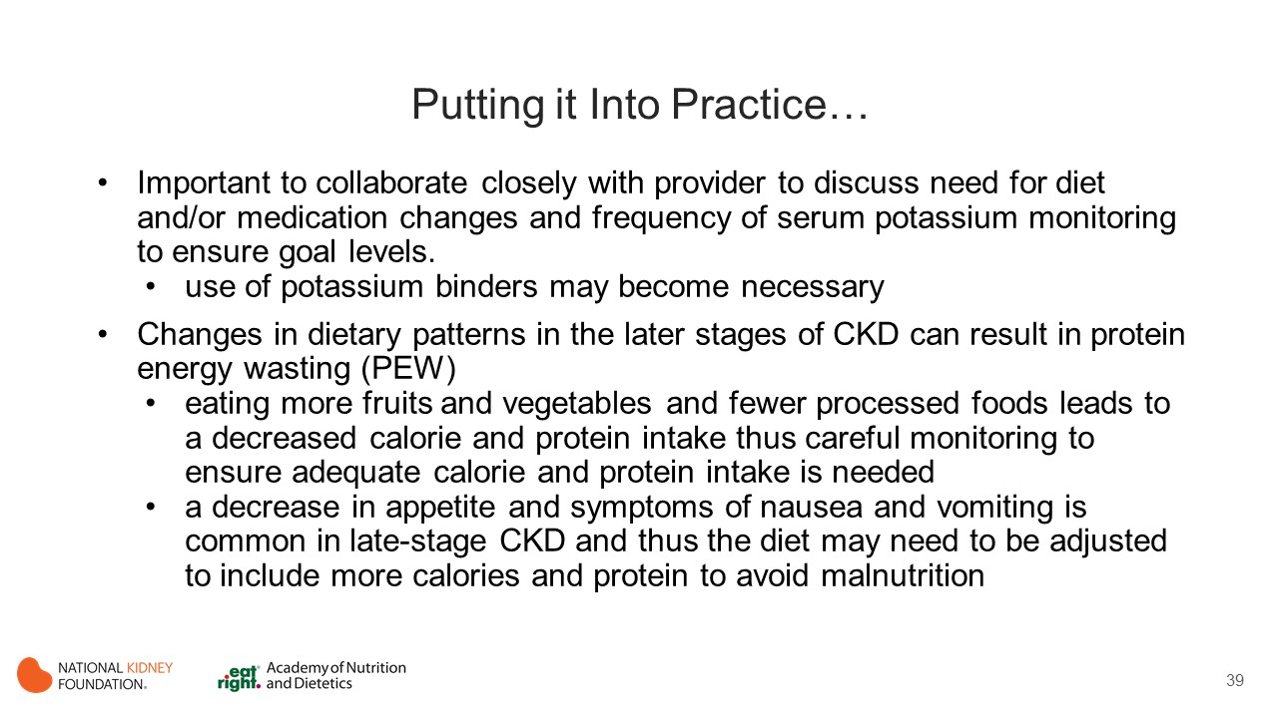
Notes:
Important to collaborate closely with provider to discuss the need for diet and/or medication changes and frequency of serum K monitoring to ensure goal levels. When hyperkalemia occurs, adjusting diet or dosing of medication(s) responsible for the elevated K may be pursued however if adequate calorie and protein intake is in jeopardy with a further diet change or the patient must remain on offending medications to protect their heart and kidneys, introduction of potassium binders may be in order. Potassium binders are medications that can bind extra K in the bowel thus allowing the excess K to be removed from the body via the stool, thereby bypassing its absorption into the bloodstream where it can lead to hyperkalemia and significant harm to the patient.
Changes in dietary patterns in the later stages of CKD can result in protein energy wasting (PEW)
eating more fruits and vegetables and fewer processed foods leads to a decreased calorie and protein intake thus careful monitoring to ensure adequate calorie and protein intake is required to prevent PEW
a decrease in appetite and symptoms of nausea and vomiting is common in late-stage CKD and thus the diet may need to be adjusted to include more calories and protein to avoid malnutrition. This is very important at once PEW is present it is difficult to reverse and affects morbidity and mortality in CKD patients who require renal replacement therapy.
Individualized support and follow-up is required to assist patients in implementing and adhering to complex dietary changes while ensuring proper management of comorbid conditions and maintaining good nutritional status.

Slide 40


Slide 41
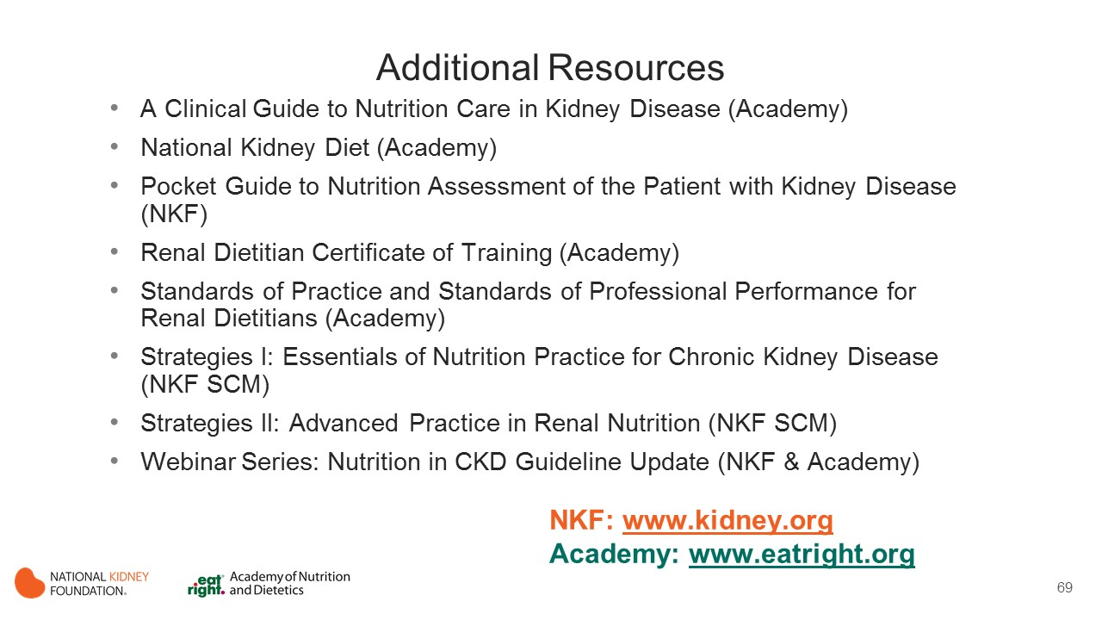
Notes:
These resources from the Academy of Nutrition and Dietetics and the National Kidney Foundation provide additional information to support implementation of the KDOQI Guideline for Nutrition in CKD.

Slide 42


